Slide 1



Anggi Firdian Saputra
14th August 2022

Slide 2

Outline
Executive Summary
Introduction
Methodology
Results
Conclusion
Appendix

Slide 3
Executive Summary
Summary of methodologies
This project follows these steps:
Data Collection
Data Wrangling
Exploratory Data Analysis
Interactive Visual Analytics
Predictive Analysis (Classification)
Summary of all results
This project produced the following outputs and visualizations:
Exploratory Data Analysis (EDA) results
Geospatial analytics
Interactive dashboard
Predictive analysis of classification models

Slide 4
Introduction
Project background and context
Commercial Space Age is Here
Space X has the best pricing ($62 million vs. $165 million USD)
Largely due to the ability to recover part of the rocket (Stage 1)
Space Y wants to compete with Space X.
Problems you want to find answers
Space Y tasks us to train a machine learning model to predict successful Stage 1 recovery

Slide 5

Section 1

Slide 6
Methodology
Executive Summary
Data collection methodology
Making GET requests to the SpaceX REST API
Web Scraping
Perform data wrangling
Using the .fillna() method to remove NaN values
Using the .value_counts() method to determine the following:
Number of launches on each site
Number and occurrence of each orbit
Number and occurrence of mission outcome per orbit type
Creating a landing outcome label that shows the following:
0 when the booster did not land successfully
1 when the booster did land successfully
Perform exploratory data analysis (EDA) using visualization and SQL
Using SQL queries to manipulate and evaluate the SpaceX dataset
Using Pandas and Matplotlib to visualize relationships between variables, and determine patterns
Perform interactive visual analytics using Folium and Plotly Dash
Geospatial analytics using Folium
Creating an interactive dashboard using Plotly Dash
Perform predictive analysis using classification models
Using Scikit-Learn to:
Pre-process (standardize) the data
Split the data into training and testing data using train_test_split
Train different classification models
Find hyperparameters using GridSearchCV
Plotting confusion matrices for each classification model
Assessing the accuracy of each classification model

Slide 7
Data Collection - Space x REST API
Using the SpaceX API to retrieve data about launches, including information about the rocket used, payload delivered, launch specifications, landing specifications, and landing outcome.
Data collection process.
GitHub url:
Request (Space X APIs)
Filter data to only include Falcon 9 launches
Imputate missing PayloadMass values with mean
https://github.com/navassherif98/IBM_Data_Science_Professional_Certification/blob/master/10.Applied_Data_Science_Capstone/Week%201%20Introduction/Data%20Collection%20Api%20.ipynb
.JSON file + Lists(Launch Site, Booster Version, Payload Data)
Cast dictionary to a DataFrame
Json_normalize to DataFrame data from JSON
Dictionary relevant data

Slide 8
Data Collection – Web Scraping
Web scraping to collect Falcon 9 historical launch records from a Wikipedia page titled List of Falcon 9 and Falcon Heavy launches.
GitHub url:
https://github.com/navassherif98/IBM_Data_Science_Professional_Certification/blob/master/10.Applied_Data_Science_Capstone/Week%201%20Introduction/Data%20Collection%20with%20Web%20Scraping.ipynb
Request Wikipedia
html
Cast dictionary to DataFrame
Iterate through table cells to extract data to dictionary
BeautifulSoup
html5lib Parser
Find launch info html table
Create dictionary

Slide 9
Data Wrangling/Data Manipulation
Initial Data Exploration:
Using the .value_counts() method to determine the following:
Number of launches on each site
Number and occurrence of each orbit
Number and occurrence of landing outcome per orbit type
Data Wrangling:
To determine whether a booster will successfully land, it is best to have a binary column, i.e., where the value is 1 or 0, representing the success of the landing.
This is done by:
Defining a set of unsuccessful (bad) outcomes, bad_outcome
Creating a list, landing_class, where the element is 0 if the corresponding row in Outcome is in the set bad_outcome, otherwise, it’s 1.
Create a Class column that contains the values from the list landing_class
Export the DataFrame as a .csv file.
GitHub url:
https://github.com/navassherif98/IBM_Data_Science_Professional_Certification/blob/master/10.Applied_Data_Science_Capstone/Week%201%20Introduction/Data%20wrangling%20.ipynb
Data Wrangling Process
Create a training label with landing outcomes where successful = 1 & failure = 0.
Outcome column has two components: ‘Mission Outcome’ ‘Landing Location’
New training label column ‘class’ with a value of 1 if ‘Mission Outcome’ is True and 0 otherwise.
True ASDS, True RTLS, & True Ocean – set to -> 1
None None, False ASDS, None ASDS, False Ocean, False RTLS – set to -> 0

Slide 10
EDA with Data Visualization
SCATTER CHARTS
BAR CHART
LINE CHARTS
Scatter charts were produced to visualize the relationships between:
Flight Number and Launch Site
Payload and Launch Site
Orbit Type and Flight Number
Payload and Orbit Type
A bar chart was produced to visualize the relationship between:
Success Rate and Orbit Type
Line charts were produced to visualize the relationships between:
Success Rate and Year (i.e. the launch success yearly trend)
Scatter charts are useful to observe relationships, or correlations, between two numeric variables.
GitHub url:
https://github.com/navassherif98/IBM_Data_Science_Professional_Certification/blob/master/10.Applied_Data_Science_Capstone/Week%202%20EDA/EDA%20with%20Visualization.ipynb
Bar charts are used to compare a numerical value to a categorical variable. Horizontal or vertical bar charts can be used, depending on the size of the data.
Line charts contain numerical values on both axes, and are generally used to show the change of a variable over time.

Slide 11
EDA with SQL
GitHub url:
https://github.com/navassherif98/IBM_Data_Science_Professional_Certification/blob/master/10.Applied_Data_Science_Capstone/Week%202%20EDA/EDA%20with%20SQL.ipynb
The SQL queries performed on the data set were used to:
Display the names of the unique launch sites in the space mission
Display 5 records where launch sites begin with the string ‘CCA’
Display the total payload mass carried by boosters launched by NASA (CRS)
Display the average payload mass carried by booster version F9 v1.1
List the date when the first successful landing outcome on a ground pad was achieved
List the names of the boosters which had success on a drone ship and a payload mass between 4000 and 6000 kg
List the total number of successful and failed mission outcomes
List the names of the booster versions which have carried the maximum payload mass
List the failed landing outcomes on drone ships, their booster versions, and launch site names for 2015
Rank the count of landing outcomes (such as Failure (drone ship) or Success (ground pad)) between the dates 2010-06-04 and 2017-03-20, in descending order.

Slide 12
Build an Interactive Map with Folium
Folium maps mark Launch Sites, successful and unsuccessful landings, and a proximity example to key locations: Railway, Highway, Coast, and City.
This allows us to understand why launch sites may be located where they are. Also visualizes successful landings relative to location.
Add a folium.Circle and folium.Marker for each launch site on the launch map to mark.
To put the launches into clusters, for each launch, add a folium.Marker to the MarkerCluster() object.
To explore the proximities of launch sites, distances between points can be calculated using the Lat and Long values.
After marking a point using the Lat and Long values, create a folium.Marker object to show the distance.
To display the distance line between two points, draw a folium.PolyLine and add this to the map.
GitHub url:
https://github.com/navassherif98/IBM_Data_Science_Professional_Certification/blob/master/10.Applied_Data_Science_Capstone/Week%203%20Interactive%20Visual%20Analytics%20and%20Dashboard/Interactive%20Visual%20Analytics%20with%20Folium.ipynb

Slide 13
Build a Dashboard with Plotly Dash
The following plots were added to a Plotly Dash dashboard to have an interactive visualization of the data.
Dashboard includes a pie chart and a scatter plot.
Pie chart (px.pie()) showing the total successful launches per site
This makes it clear to see which sites are most successful
The chart could also be filtered (using a dcc.Dropdown() object) to see the success/failure ratio for an individual site
Scatter graph (px.scatter()) to show the correlation between outcome (success or not) and payload mass (kg)
This could be filtered (using a RangeSlider() object) by ranges of payload masses
It could also be filtered by booster version
All sites or individual site and payload mass on a slider between 0 and 10000 kg.
GitHub url:
https://github.com/navassherif98/IBM_Data_Science_Professional_Certification/blob/master/10.Applied_Data_Science_Capstone/Week%203%20Interactive%20Visual%20Analytics%20and%20Dashboard/spacex_dash_app.py

Slide 14
Predictive Analysis (Classification)
Model Evaluation
For each chosen algorithm:
Using the output GridSearchCV object:
Check the tuned hyperparameters (best_params_)
Check the accuracy (score and best_score_)
Plot and examine the Confusion Matrix
Finding the Best Classification Model
Review the accuracy scores for all chosen algorithms
The model with the highest accuracy score is determined as the best performing model
Model Development Process
Split label column ‘Class’ from dataset
Score models on split test set
Confusion Matrix for all models
Fit and Transform
Features using
Standard Scaler
Use GridSearchCV, on LogReg, SVM, Decision Tree, and KNN models
Barplot to compare scores of models
Train_test_split data
GridSearchCV
(cv=10) to find optimal parameters
GitHub url:
https://github.com/navassherif98/IBM_Data_Science_Professional_Certification/blob/master/10.Applied_Data_Science_Capstone/Week%204%20Predictive%20Analysis%20(Classification)/Machine%20Learning%20Prediction.ipynb

Slide 15

Results
This is a preview of the Plotly dashboard. The following sides will show the results of EDA with visualization, EDA with SQL, Interactive Map with Folium, and finally the results of our model with about 83% accuracy for LR and SVM, 94.44% for DT, and 88% for KNN.

Slide 16

Section 2

Slide 17
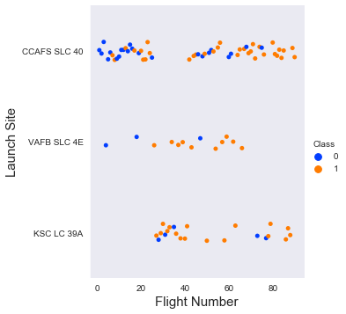
Flight Number vs. Launch Site
The scatter plot of Launch Site vs. Flight Number shows that:
As the number of flights increases, the rate of success at a launch site increases.
Most of the early flights (flight numbers < 30) were launched from CCAFS SLC 40, and were generally unsuccessful.
The flights from VAFB SLC 4E also show this trend, that earlier flights were less successful.
No early flights were launched from KSC LC 39A, so the launches from this site are more successful.
Above a flight number of around 30, there are significantly more successful landings (Class = 1).
Graphic suggests an increase in success rate over time (indicated in Flight Number). Likely a big breakthrough around flight 20 which significantly increased the success rate. CCAFS appears to be the main launch site as it has the most volume.
Scatter Plot of Flight Number vs. Launch Site.

Slide 18
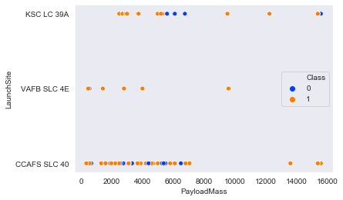
Payload vs. Launch Site
The scatter plot of Launch Site vs. Payload Mass shows that:
Above a payload mass of around 7000 kg, there are very few unsuccessful landings, but there is also far fewer data for these heavier launches.
There is no clear correlation between payload mass and success rate for a given launch site.
All sites launched a variety of payload masses, with most of the launches from CCAFS SLC 40 being comparatively lighter payloads (with some outliers).
Payload mass appears to fall mostly between 0-6000 kg. Different launch sites also seem to use different payload mass.
Scatter Plot of Payload vs. Launch Site.

Slide 19
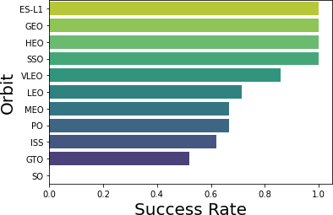
Success Rate vs. Orbit Type
The bar chart of Success Rate vs. Orbit Type shows that the following orbits have the highest (100%) success rate:
ES-L1 (Earth-Sun First Lagrangian Point)
GEO (Geostationary Orbit)
HEO (High Earth Orbit)
SSO (Sun-synchronous Orbit)
The orbit with the lowest (0%) success rate is:
SO (Heliocentric Orbit)
VLEO (14) has decent success rate and attempts
GTO (27) has around a 50% success rate but the largest sample
Bar Chart of Success Rate vs. Orbit Type.

Slide 20
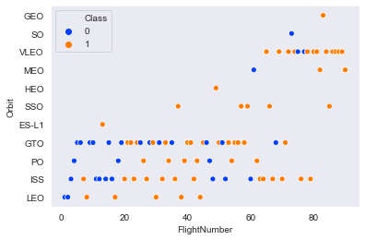
Flight Number vs. Orbit Type
This scatter plot of Orbit Type vs. Flight number shows a few useful things that the previous plots did not, such as:
The 100% success rate of GEO, HEO, and ES-L1 orbits can be explained by only having 1 flight into the respective orbits.
The 100% success rate in SSO is more impressive, with 5 successful flights.
There is little relationship between Flight Number and Success Rate for GTO.
Generally, as Flight Number increases, the success rate increases. This is most extreme for LEO, where unsuccessful landings only occurred for the low flight numbers (early launches).
Launch Orbit preferences changed over Flight Number.
Launch Outcome seems to correlate with this preference.
SpaceX started with LEO orbits which saw moderate success LEO and returned to VLEO in recent launches
SpaceX appears to perform better in lower orbits or Sun-synchronous orbits
Scatter Point of Flight Number vs. Orbit Typer.

Slide 21
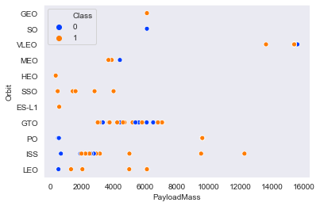
Payload vs. Orbit Type
This scatter plot of Orbit Type vs. Payload Mass shows that:
The following orbit types have more success with heavy payloads:
PO (although the number of data points is small)
ISS
LEO
For GTO, the relationship between payload mass and success rate is unclear.
VLEO (Very Low Earth Orbit) launches are associated with heavier payloads, which makes intuitive sense.
LEO and SSO seem to have relatively low payload mass
Scatter Point of Payload vs. Orbit Type.

Slide 22
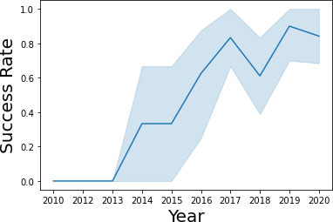
Launch Success Yearly Trend
The line chart of yearly average success rate shows that:
Between 2010 and 2013, all landings were unsuccessful (as the success rate is 0).
After 2013, the success rate generally increased, despite small dips in 2018 and 2020.
After 2016, there was always a greater than 50% chance of success.
Success generally increases over time since 2013 with a slight dip in 2018
Success in recent years at around 80%
Line Chart of Yearly Average Success Rate.

Slide 23
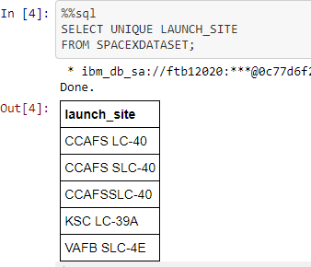
All Launch Site Names
Find the names of the unique launch sites
The word UNIQUE returns only unique values from the LAUNCH_SITE column of the SPACEXTBL table.
CCAFS SLC-40 and CCAFSSLC-40 likely all represent the same launch site with data entry errors.
CCAFS LC-40 was the previous name.
Likely only 3 unique launch_site values: CCAFS SLC-40, KSC LC-39A, VAFB SLC-4E

Slide 24
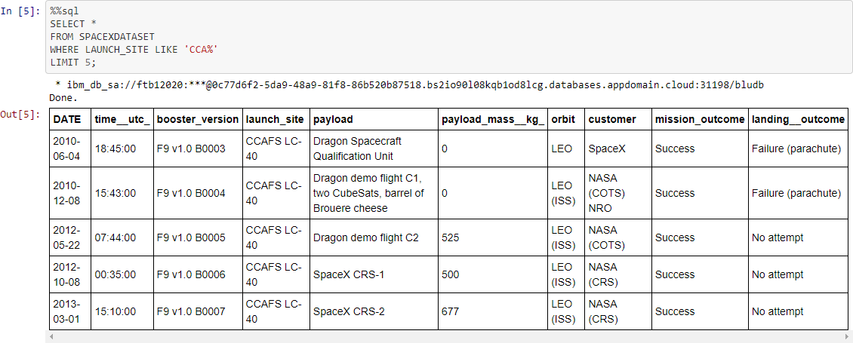
Launch Site Names Begin with 'CCA'
First five entries in the database with Launch Site name beginning with CCA.
LIMIT 5 fetches only 5 records, and the LIKE keyword is used with the wild card ‘CCA%’ to retrieve string values beginning with ‘CCA’.

Slide 25
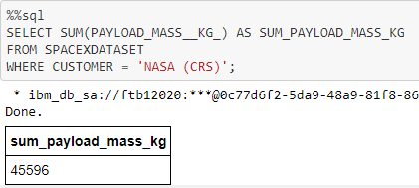
Total Payload Mass
Calculate the total payload carried by boosters from NASA
The SUM keyword is used to calculate the total of the LAUNCH column, and the SUM keyword (and the associated condition) filters the results to only boosters from NASA (CRS).

Slide 26
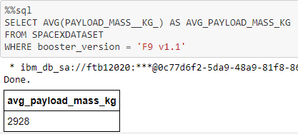
Average Payload Mass by F9 v1.1
Calculate the average payload mass carried by booster version F9 v1.1
The AVG keyword is used to calculate the average of the PAYLOAD_MASS__KG_ column, and the WHERE keyword (and the associated condition) filters the results to only the F9 v1.1 booster version.

Slide 27
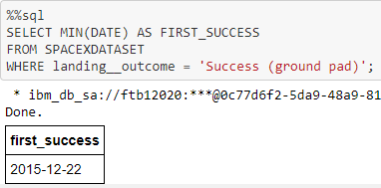
First Successful Ground Landing Date
Find the dates of the first successful landing outcome on a ground pad
The MIN keyword is used to calculate the minimum of the DATE column, i.e. the first date, and the WHERE keyword (and the associated condition) filters the results to only the successful ground pad landings.
First ground pad landing wasn’t until the end of 2015.
Successful landings in general appear starting 2014.

Slide 28
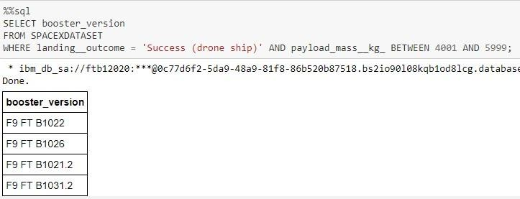
Successful Drone Ship Landing with Payload between 4000 and 6000
List the names of boosters that have successfully landed on a drone ship and had payload mass greater than 4000 but less than 6000
The WHERE keyword is used to filter the results to include only those that satisfy both conditions in the brackets (as the AND keyword is also used). The BETWEEN keyword allows for 4000 < x < 6000 values to be selected.

Slide 29
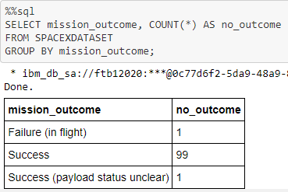
Total Number of Successful and Failure Mission Outcomes
Calculate the total number of successful and failure mission outcomes
The COUNT keyword is used to calculate the total number of mission outcomes, and the GROUP BY keyword is also used to group these results by the type of mission outcome.

Slide 30
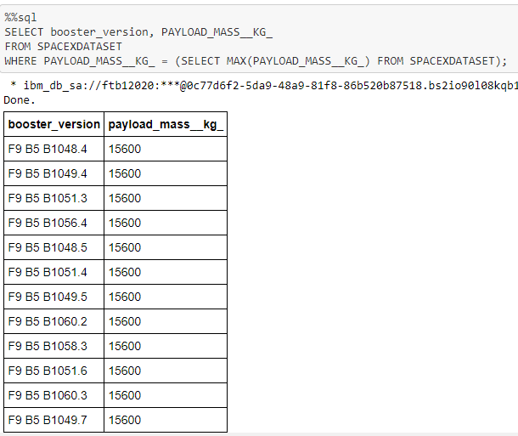
Boosters Carried Maximum Payload
List the names of the booster which have carried the maximum payload mass.
A subquery is used here. The SELECT statement within the brackets finds the maximum payload, and this value is used in the WHERE condition. The DISTINCT keyword is then used to retrieve only distinct /unique booster versions.
This query returns the booster versions that carried the highest payload mass of 15600 kg.
These booster versions are very similar and all are of the F9 B5 B10xx.x variety.
This likely indicates payload mass correlates with the booster version that is used.

Slide 31
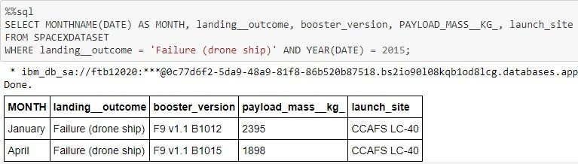
2015 Launch Records
List the failed landing_outcomes in drone ship, their booster versions, and launch site names for in year 2015
The WHERE keyword is used to filter the results for only failed landing outcomes, AND only for the year of 2015.
Launch site of 2015 launches where stage 1 failed to land on a drone ship.
There were two such occurrences.

Slide 32
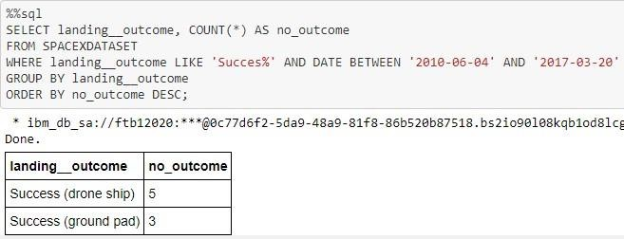
Rank Landing Outcomes Between 2010-06-04 and 2017-03-20
Rank the count of landing outcomes (such as Failure (drone ship) or Success (ground pad)) between the date 2010-06-04 and 2017-03-20, in descending order
The WHERE keyword is used with the BETWEEN keyword to filter the results to dates only within those specified. The results are then grouped and ordered, using the keywords GROUP BY and ORDER BY, respectively, where DESC is used to specify the descending order.

Slide 33

Section 3

Slide 34




All Launch Sites’ Location Markers on A Global Map
The left map shows all launch sites relative US map. The right map shows the two Florida launch sites since they are very close to each other. All launch sites are near the ocean.
All SpaceX launch sites are on the coasts of the United States of America, specifically Florida and California.

Slide 35






The Color-labeled Launch Outcomes on The Map
Launches have been grouped into clusters and annotated with green icons for successful launches, and red icons for failed launches.
In this example VAFB SLC-4E shows 4 successful landings and 6 failed landings, and KSC LC-39A shows 8 successful landings and 3 failed landings.
CCAFS SLC-40 and CCAFS LC-40
VAFB SLC-4E
KSC LC-39A
$$=$$

Slide 36
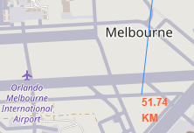
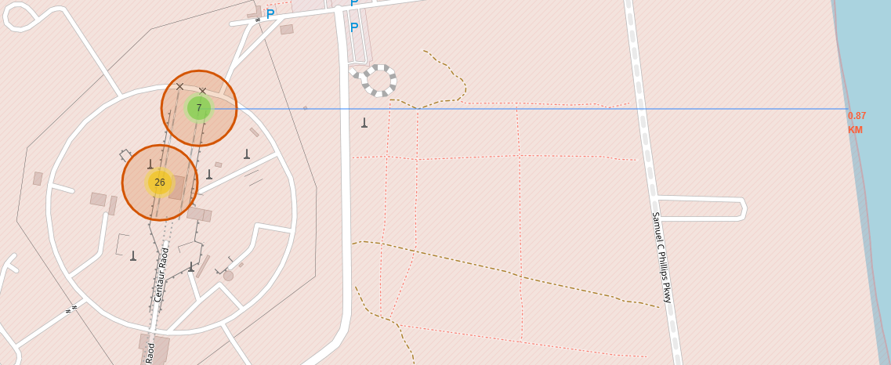
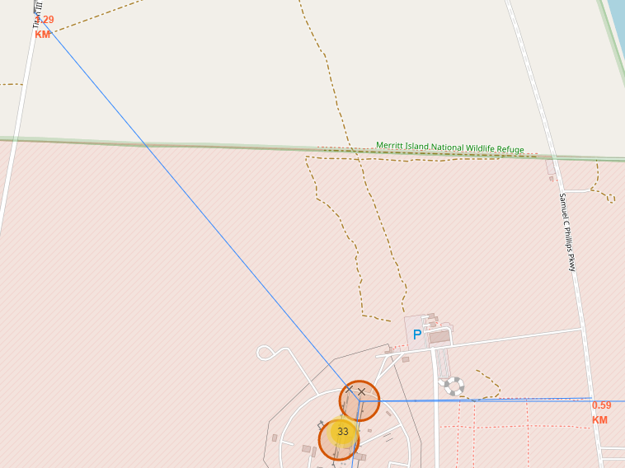
Proximity of Launch Sites to Other Points of Interest
The coastline is only 0.87 km due East.
The nearest highway is only 0.59km away.
The nearest railway is only 1.29 km away.
The nearest city is 51.74 km away.
Using the CCAFS SLC-40 launch site as an example site, we can understand more about the placement of launch sites.

Slide 37

Section 4

Slide 38
Launch Success Count For All Sites
The launch site KSC LC-39 A had the most successful launches, with 41.7% of the total successful launches.
This is the distribution of successful landings across all launch sites. CCAFS LC-40 is the old name of CCAFS SLC-40 so CCAFS and KSC have the same amount of successful landings, but a majority of the successful landings were performed before the name change. VAFB has the smallest share of successful landings. This may be due to a smaller sample and an increase in the difficulty of launching on the west coast.

Slide 39

Launch Site With Highest Launch Success Ratio
The launch site KSC LC-39 A also had the highest rate of successful launches, with a 76.9% success rate where 10 successful landings and 3 failed landings

Slide 40
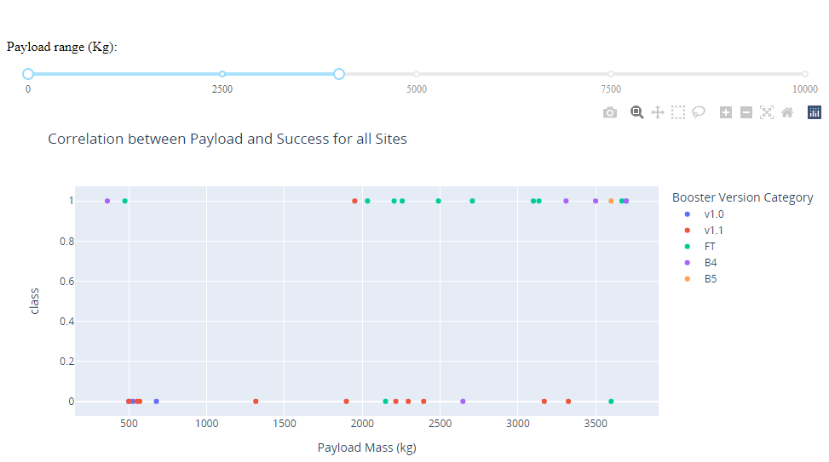

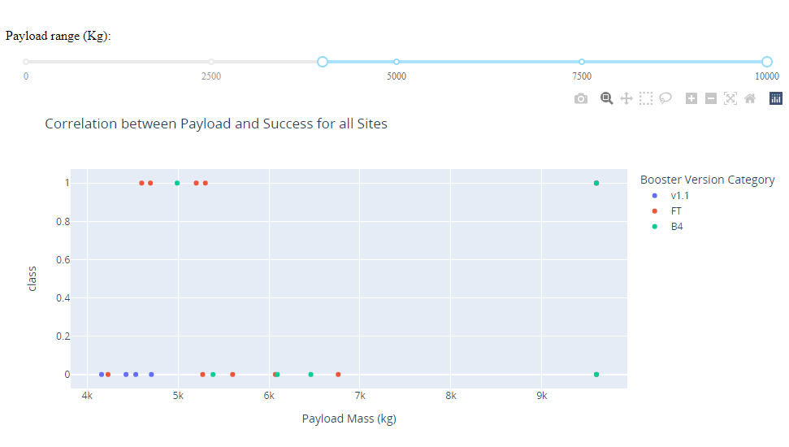
Launch Outcome vs. Payload Scatter Plot For All Sites
Low payloads
Low payloads
Massive payloads
Plotting the launch outcome vs. payload for all sites shows a gap of around 4000 kg, so it makes sense to split the data into 2 ranges:
0 – 4000 kg (low payloads)
4000 – 10000 kg (massive payloads)
From these 2 plots, it can be shown that the success for massive payloads is lower than that for low payloads.
It is also worth noting that some booster types (v1.0 and B5) have not been launched with massive payloads.
Massive payloads

Slide 41

Section 5

Slide 42
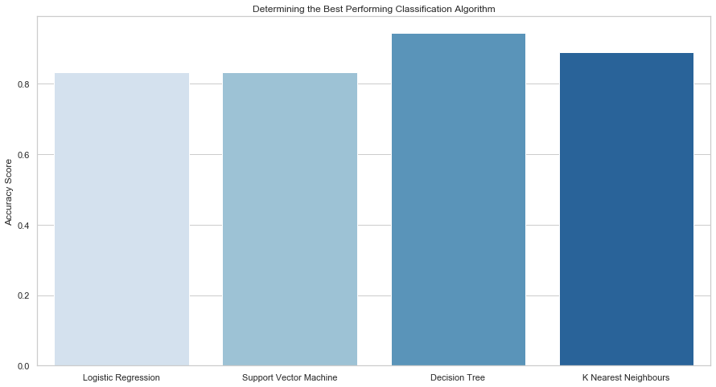
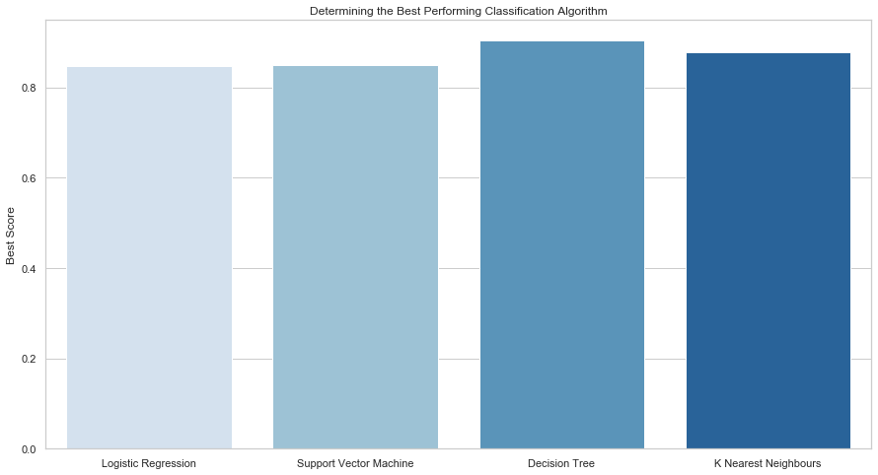
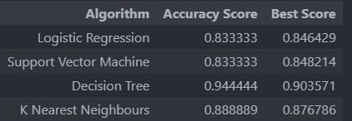
Classification Accuracy
Plotting the Accuracy Score and Best Score for each classification algorithm produces the following result:
The Decision Tree model has the highest classification accuracy
The Accuracy Score is 94.44%
The Best Score is 90.36%

Slide 43
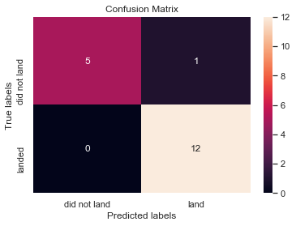
Confusion Matrix
As shown previously, best performing classification model is the Decision Tree model, with an accuracy of 94.44%.
This is explained by the confusion matrix, which shows only 1 out of 18 total results classified incorrectly (a false positive, shown in the top-right corner).
The other 17 results are correctly classified (5 did not land, 12 did land).

Slide 44
Conclusions
As the number of flights increases, the rate of success at a launch site increases, with most early flights being unsuccessful. I.e. with more experience, the success rate increases. Between 2010 and 2013, all landings were unsuccessful (as the success rate is 0). After 2013, the success rate generally increased, despite small dips in 2018 and 2020. After 2016, there was always a greater than 50% chance of success.
Orbit types ES-L1, GEO, HEO, and SSO, have the highest (100%) success rate.
The launch site KSC LC-39 A had the most successful launches, with 41.7% of the total successful launches, and also the highest rate of successful launches, with a 76.9% success rate.
The success for massive payloads (over 4000kg) is lower than that for low payloads.
The best performing classification model is the Decision Tree model, with an accuracy of 94.44%.

Slide 45
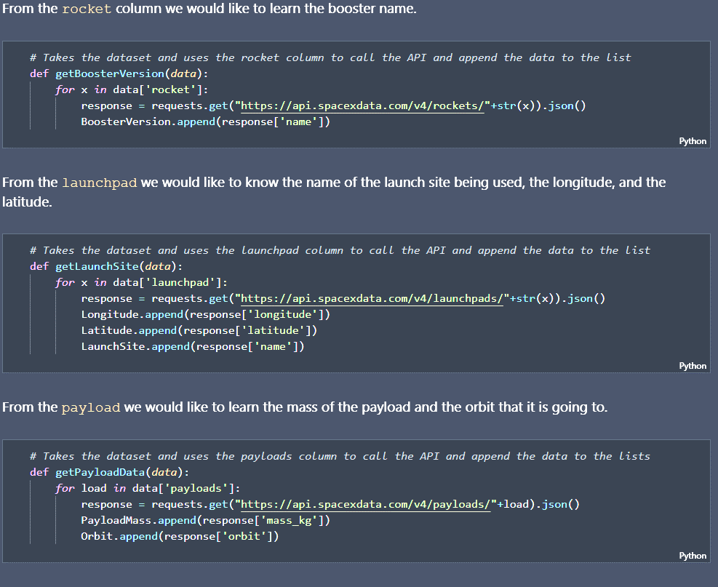
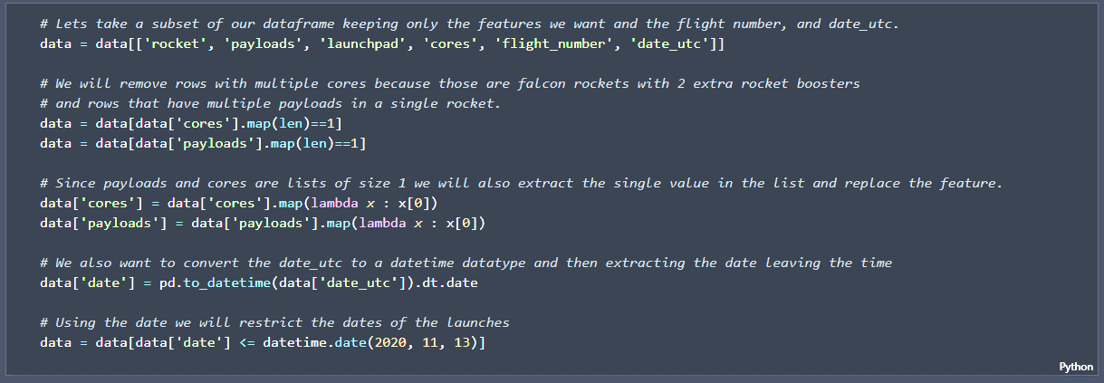
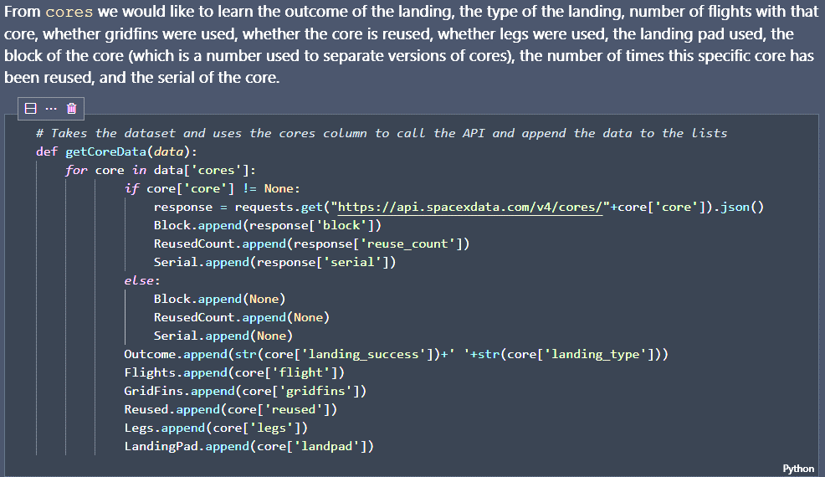
Appendix
Data Collection – Space X Rest API
Custom functions to retrieve the required information
Custom logic to clean the data

Slide 46
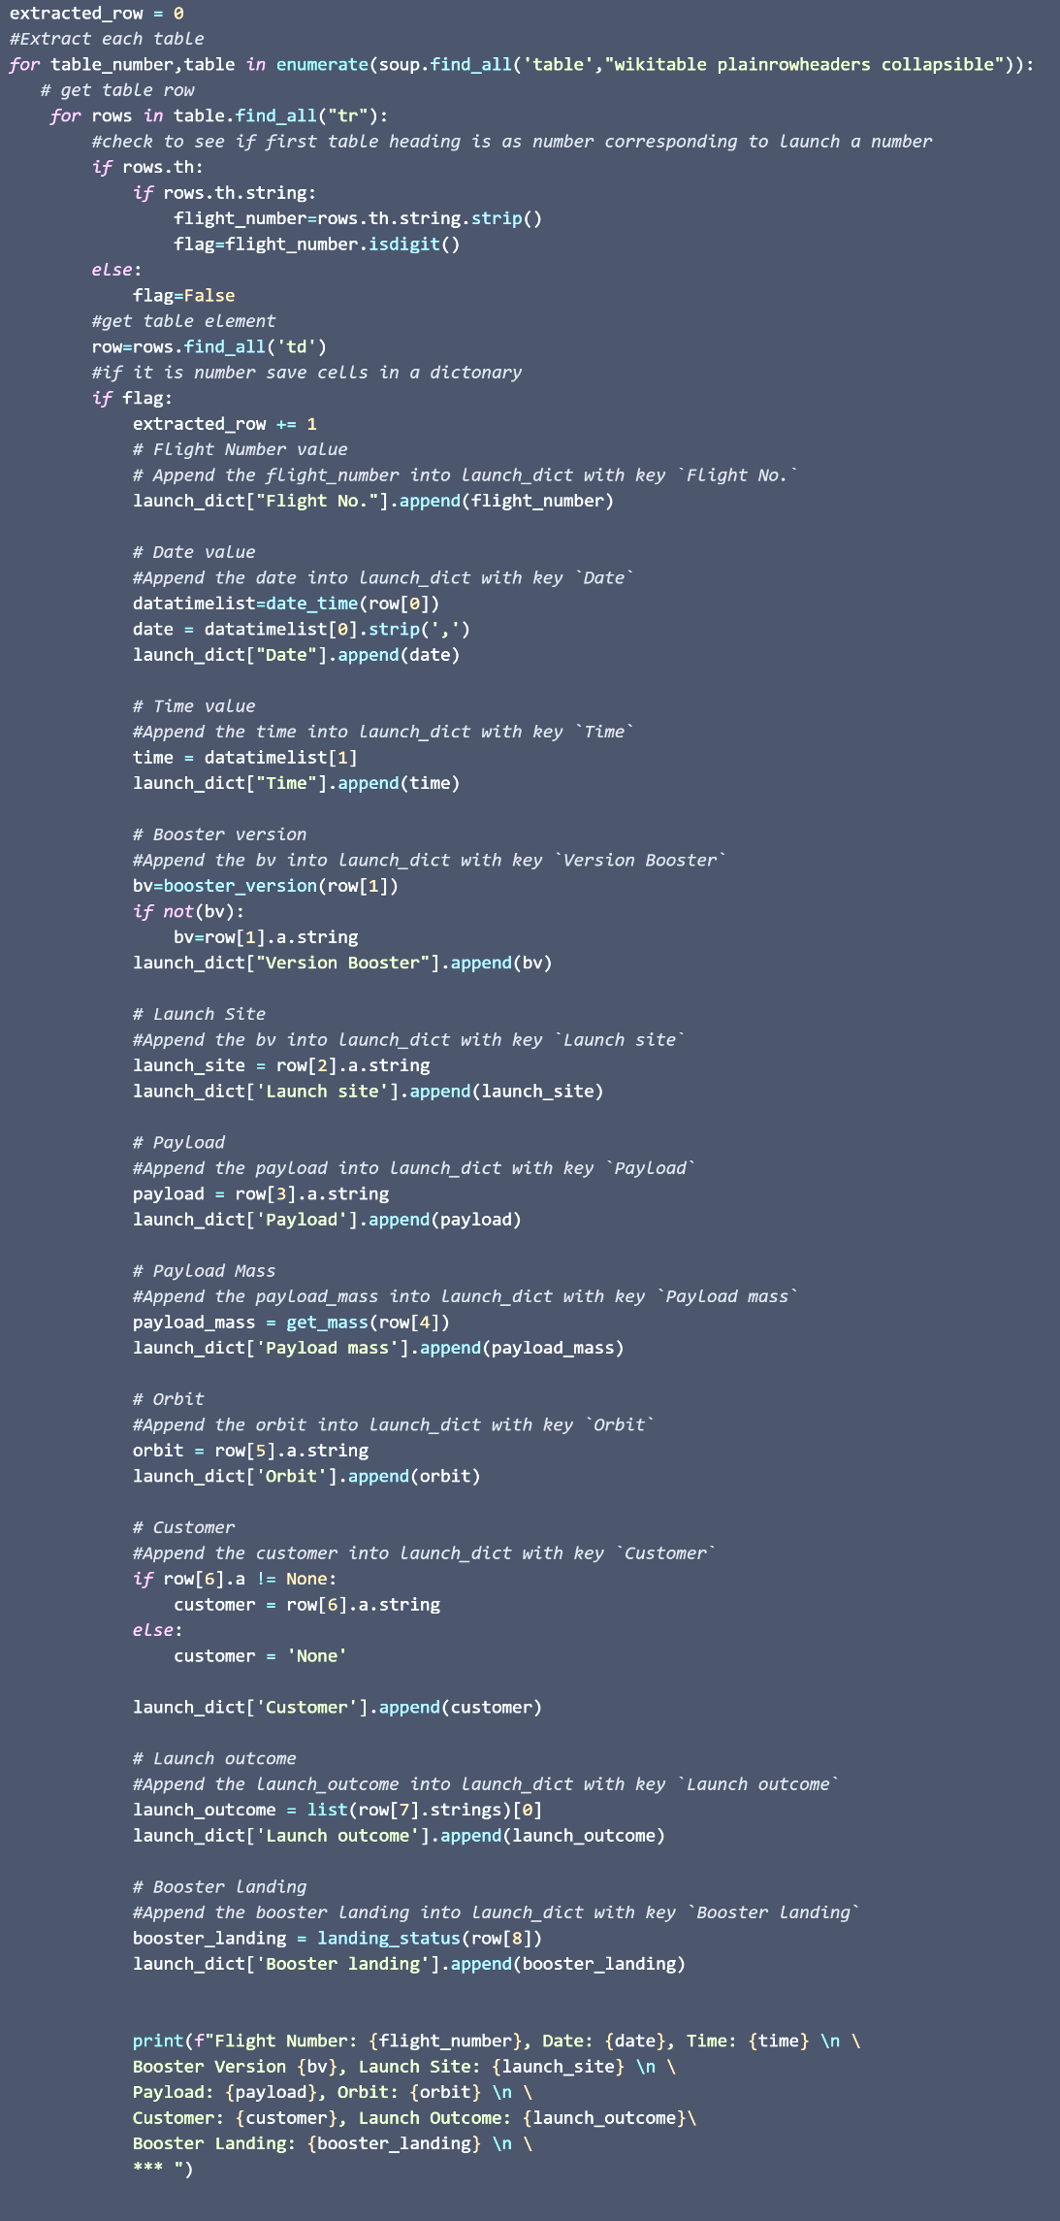
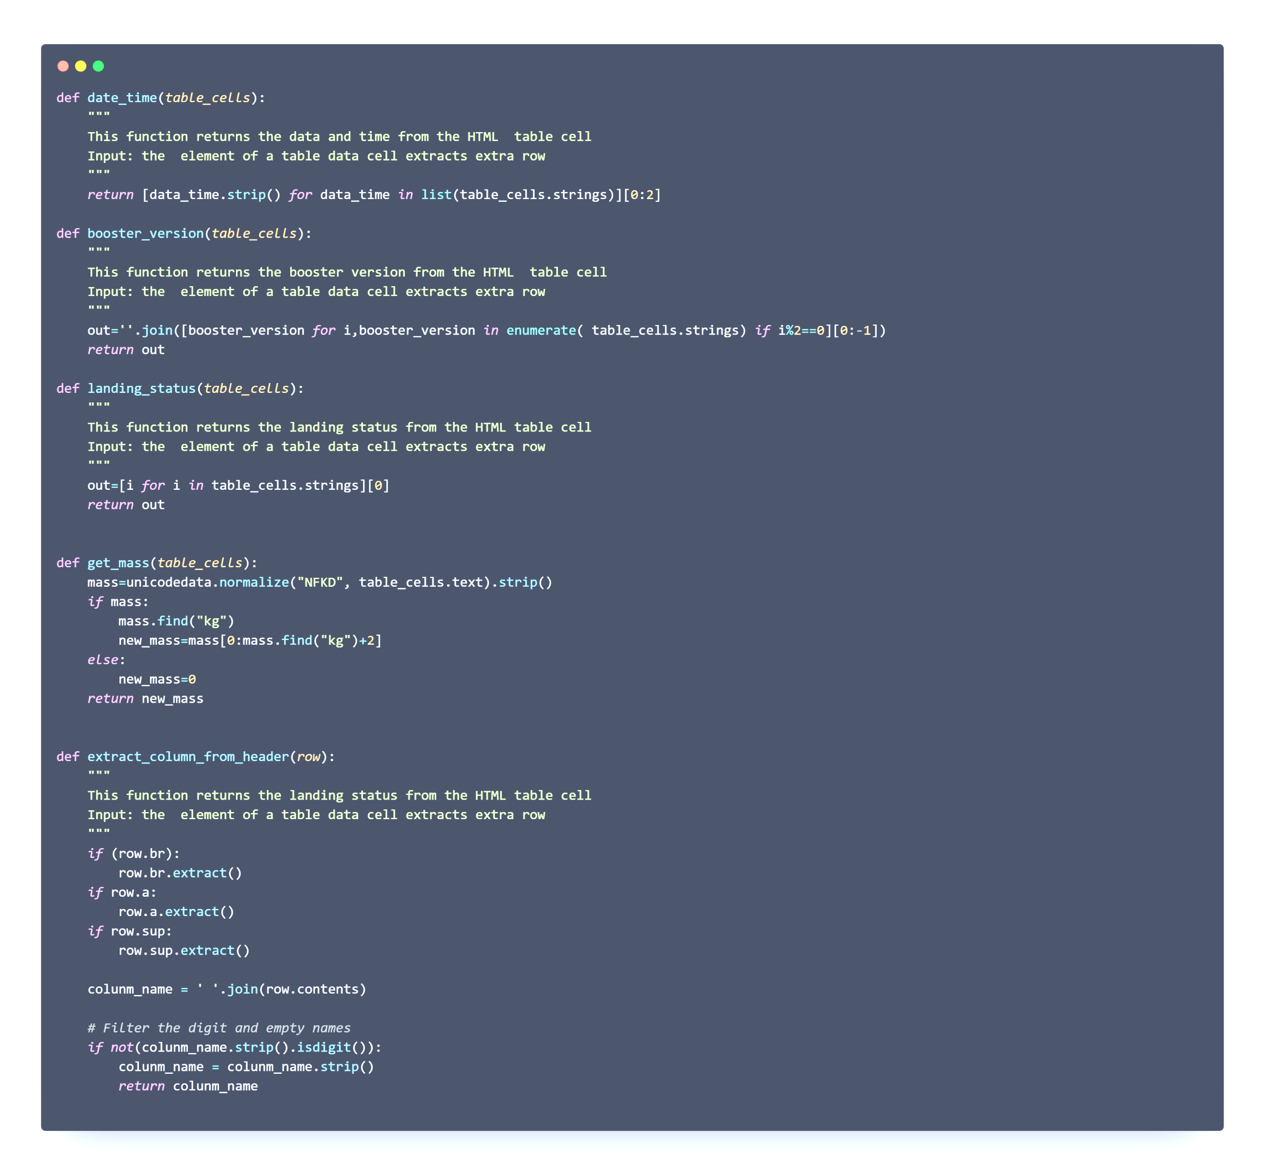
Appendix
Custom functions for web scraping
Custom logic to fill up the launch_dict values with values from the launch tables

Slide 47
Appendix
Instructors:
Instructors: Rav Ahuja, Alex Aklson, Aije Egwaikhide, Svetlana Levitan, Romeo Kienzler, Polong Lin, Joseph Santarcangelo, Azim Hirjani, Hima Vasudevan, Saishruthi Swaminathan, Saeed Aghabozorgi, Yan Luo
Special Thanks to All Instructors:
https://www.coursera.org/professional-certificates/ibm-data-science?#instructors

Slide 48


